Slide 1
Gift Advisor
Intelligent Gifting Experience

Slide 2





Problem Statement : How to make right Gift choice which is appropriate ?
Appropriate for User Persona (receiver)
Considers wide range of choices and chooses most apt one for the user
Feasible in the budget of provider
Not too much of a stress for provider
*source of image : freepik.com (non-commercial use)

Slide 3
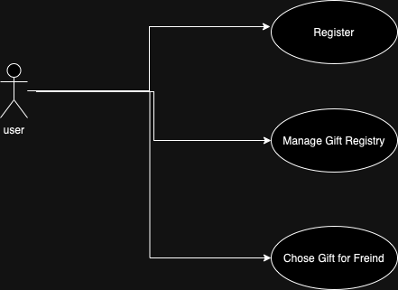
Key use-cases for Gift Advisor App
Register: Register to the application with his / her user details
Choose Gift for friend: Help user choose most appropriate gift for a friend on any specific occasion , within the budget user can afford
Create Gift Registry : Enable user to share (mark favourite) what all gifts he/she would like to receive (like a wish list)

Slide 4
Technology Choice – Object Oriented Implementation
We have chosen Python as implementation language for this application .
Why Python ?:
Its simplicity and rich libraries that can minimize coding effort
As we extend this app Python provides good AI capabilities that can be used in future
How is Python used for backend vs frontend ?
Front-end: We have chosen Python Flask is open source framework for web based GUI, it is widely used and simple to deploy. We have also incorporated HTML files.
Back-end: All logic for gift registry has been implemented with Object Oriented principles using basic python libraries

Slide 5

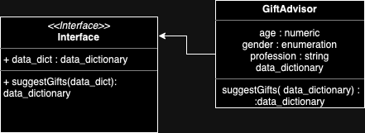
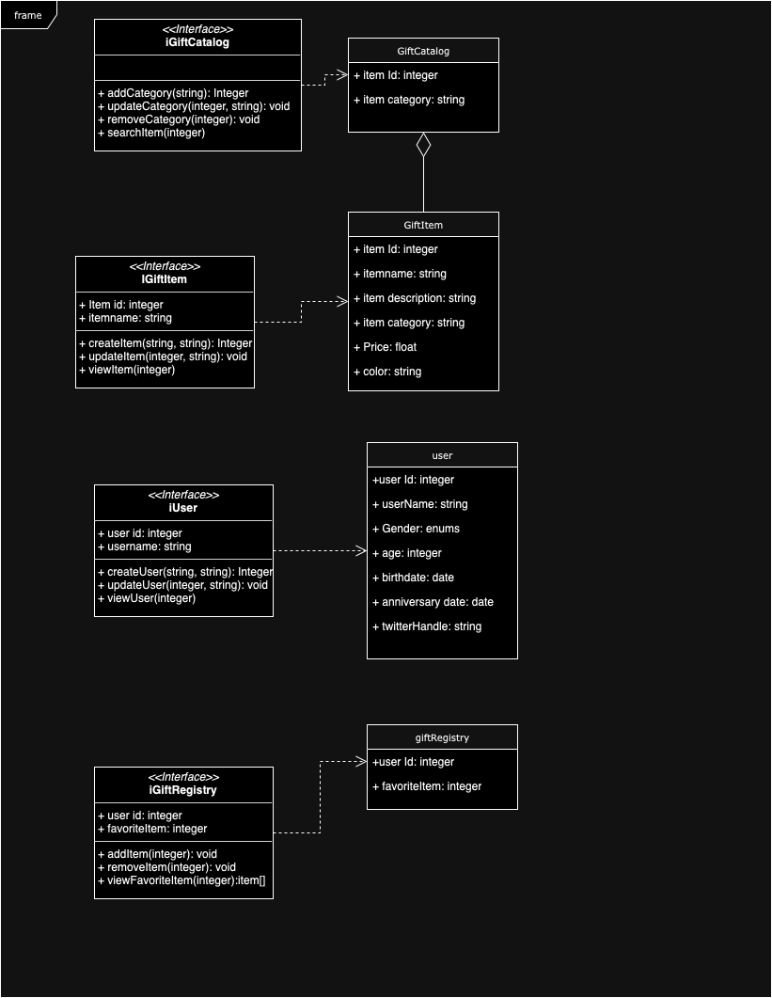
Object Oriented Design
1. OOPS principle of Abstraction & Encapsulation
Design Created using draw.io
Applied OOPS principles of self contained Objects and implementation interfaces
Notes:
Gift advisor is a real life type object abstracting how it will advise gift but providing its interface is suggestGifts()

Slide 6
2. OOPS principle of reusing Methods /Functions of real life objects
User Defined Functions
suggestGifts()
allFiles()
Pre Built function Libraries
ArgumentParser() from flask
renderTemplate() from flask
Post and get Methods on request (we have used post)

Slide 7
3. OOPS principles of inheritance
Used argumentParser() from python library and created child class ap with additional arguments have been added

Slide 8
OOPS principles of Polymorphism
We are using Python object array which demonstrates polymorphism
append() is used to append number or string or any other item which is realized using method overloading

